Slide 1

SMART INDIA HACKATHON 2026
Enterprise Cryptographic Discovery
& Analysis Tool (ECDAT)
Problem Statement ID –SIH26164
Problem Statement Title :“Enterprise Cryptographic Discovery & Analysis Tool (ECDAT)”
Theme-Block chain &Cyber Security
PS Category- Software
Team ID-MRECW
Team Name –Cypher Vault

Slide 2

Enterprise Cryptographic Discovery
& Analysis Tool (ECDAT)
Proposed Solution
Discover cryptographic usage across source code, dependencies and configurations.
Identify algorithms, key parameters, APIs, protocols and certificates.
Build a structured Cryptographic Inventory / CBOM with evidence and relationships.
Assess security and quantum exposure to identify high-priority assets.
Recommend appropriate PQC options based on the cryptographic purpose.
Prioritize findings to support practical migration planning.
Innovation & Uniqueness
Automated Cryptographic Discovery – Detects encryption algorithms and cryptographic libraries across enterprise code and systems.
Quantum-Readiness Analysis – Identifies algorithms vulnerable to future quantum attacks and highlights migration priorities.
Centralized Crypto Inventory – Creates a unified, searchable inventory of where and how cryptography is being used.
Risk-Based Intelligence – Assigns risk levels based on algorithm strength, usage, configuration and future security threats.
Actionable Migration Guidance – Recommends suitable modern and post-quantum cryptographic alternatives.
Continuous Monitoring – Enables organizations to continuously track cryptographic changes and emerging vulnerabilities.
Our Promise
“We make cryptography visible, measurable, and future-ready helping organizations discover hidden crypto risks today and prepare securely for the quantum era.”

Slide 3
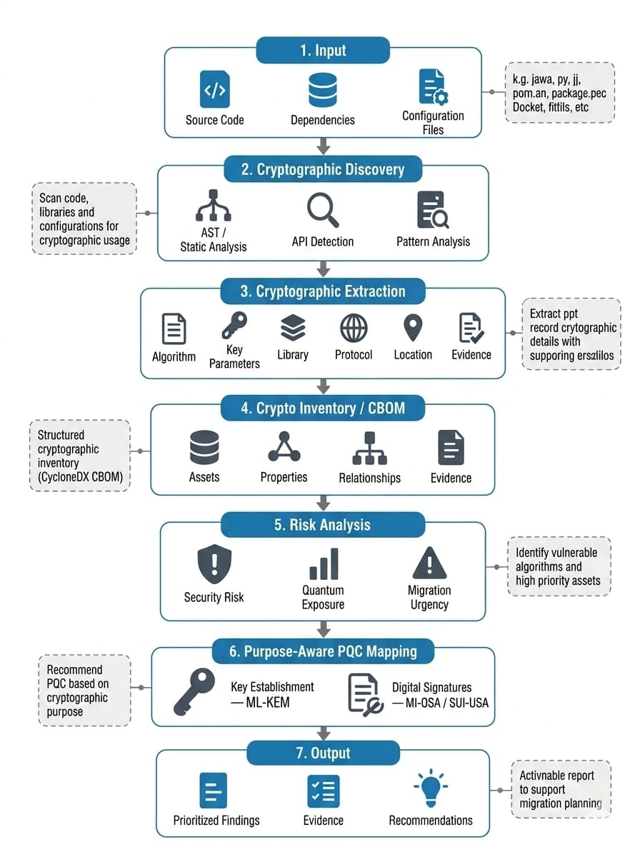
TECHNICAL APPROACH
Category | Technology/Tool | Purpose
Frontend | React | Interative dashboard UI
Frontend Language | TypeScript | Type-safe frontend development
Frontend Build | Vite | Development server&production build
Backend | Java 21 | Core application & analysis logic
Backend Framework | Spring Boot 4.1.1 | Rest API & backend services
PQC Standards | ML-KEM,ML-DSA,SLH-DSA | Post quantum alternatives

Slide 4
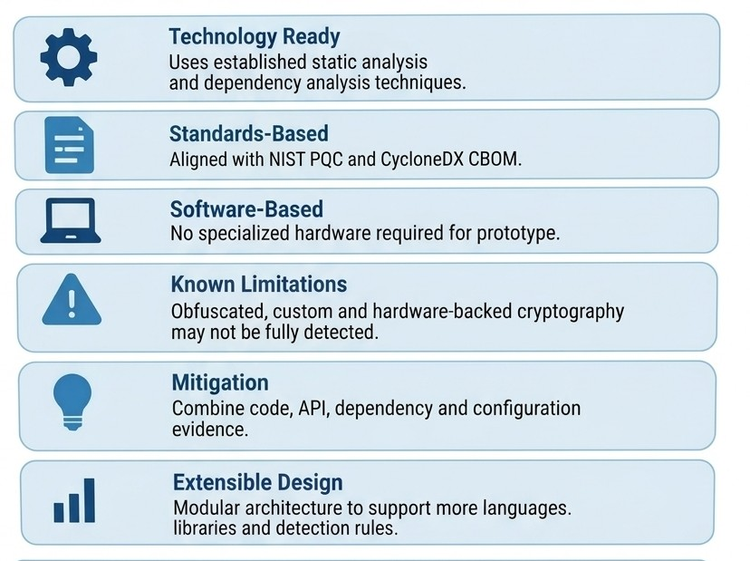
FEASIBILITY AND VIABILITY
The technology is available since it uses known methods for static analysis and dependency analysis.
It follows the standards set by NIST PQC and CycloneDX CBOM .The method based on software does not require hardware when making a prototype.
The limitations are obfuscated, custom and hardware-based cryptography.
The steps should include gathering evidence about the code, the API, the dependencies and the configuration.

Slide 5
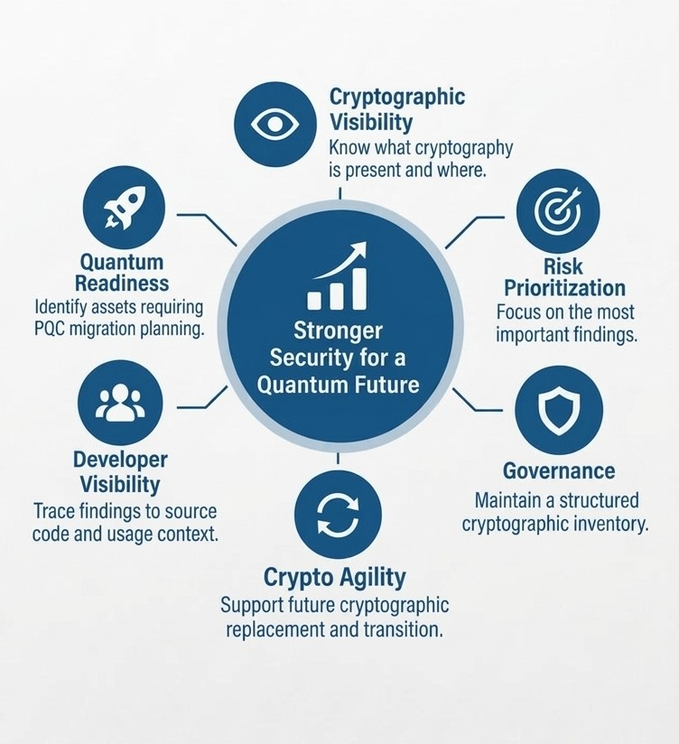
IMPACT AND BENEFITS
Migration
Purpose-aware PQC recommendations
Risk-based migration prioritization
Reduced manual discovery effort
Key Impact
Discover → Understand → Prioritize → Prepare
Development / Security Teams
Discover cryptographic usage
Locate cryptographic dependencies
Trace findings to source evidence
Identify migration requirements
Enterprise / Governance
Maintain organized cryptographic inventory
Understand security and quantum exposure
Prioritize high-risk assets
Support crypto-agility planning

Slide 6
RESEARCH AND REFERENCES
Incident | Details | Source
Cryptographic Discovery | Crypto is distributed across code, dependencies and configurations. | Yamamuro et al. 2026
Cryptographic Inventory | PQC migration requires identifying algorithms, parameters and usage. | Yamamuro et al. 2026
CBOM | Structured representation of crypto assets, relationships and evidence. | Hess 2026
Quantum Risk | RSA/ECC are vulnerable to future quantum attacks | NIST / Yamamuro et al.
HNDL Threat | Encrypted data can be captured today and decrypted later. | NIST
“Every hidden algorithm tells a story –ECDAT reveals the risks before they become threats”

